Slide 1
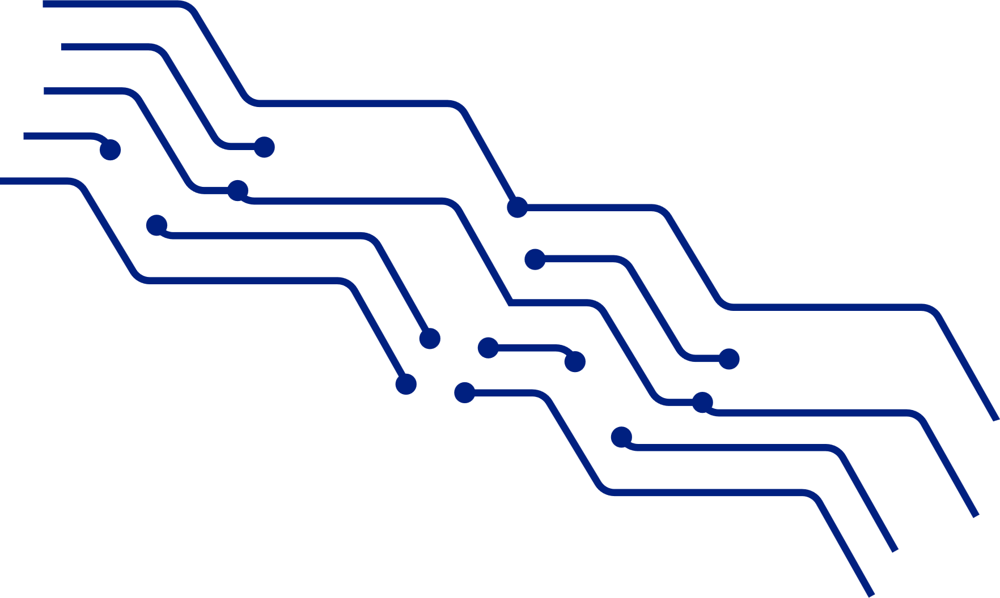
ARTIFICIAL INTELLIGENCE TECHNOLOGY
AI World
HI
Chat GPT
Jiaxing Li

Slide 2
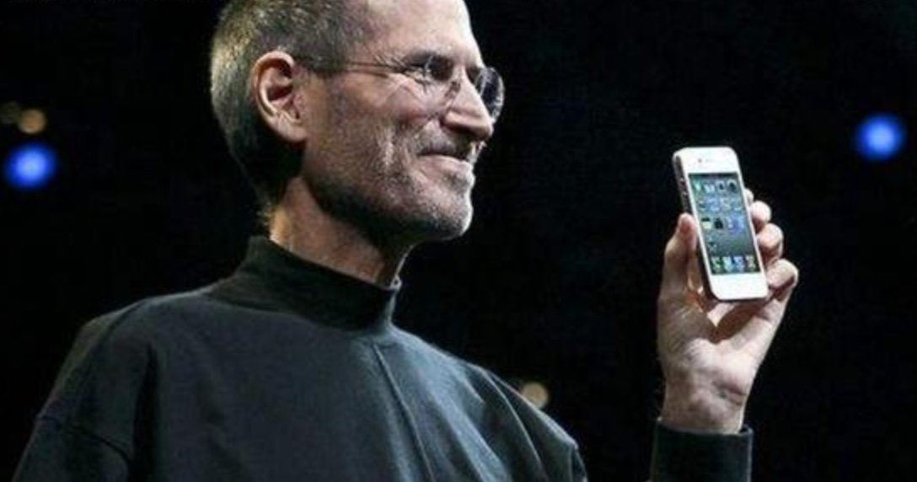
IPhone Moment
AI

Slide 3
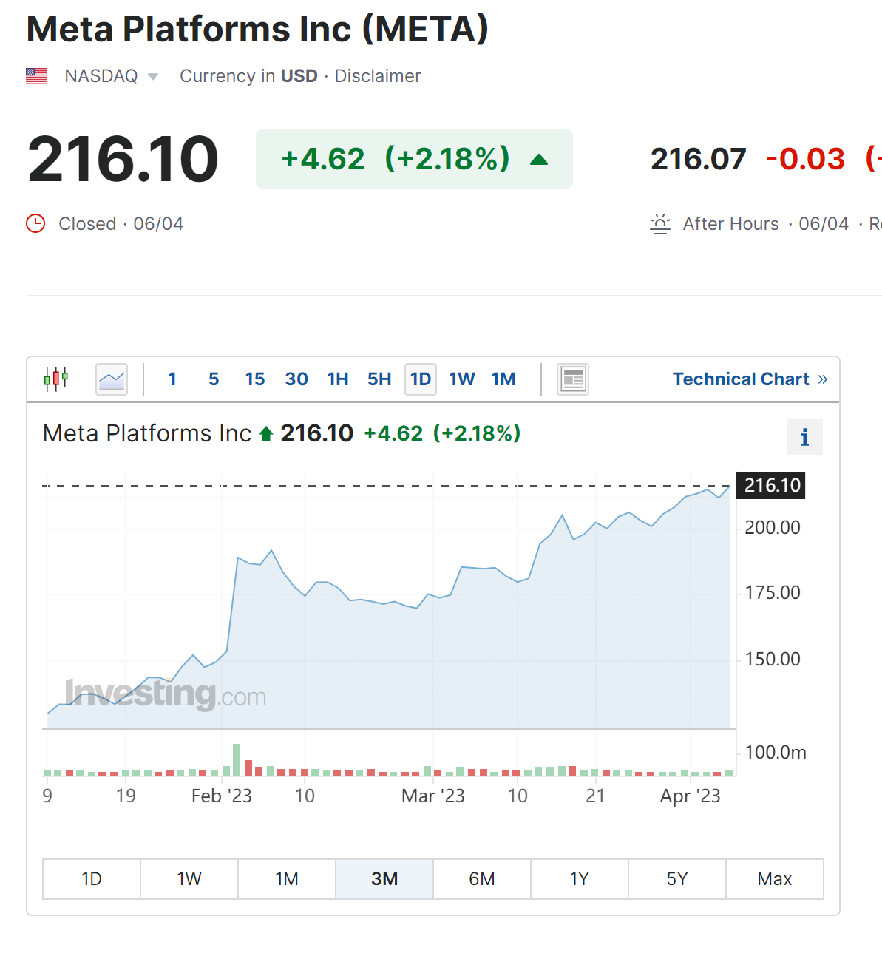
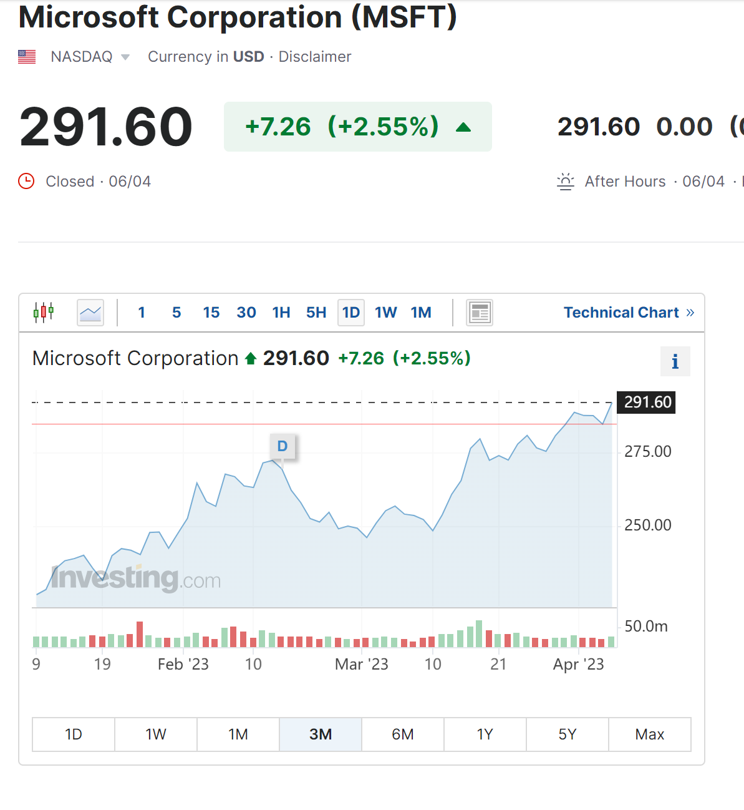
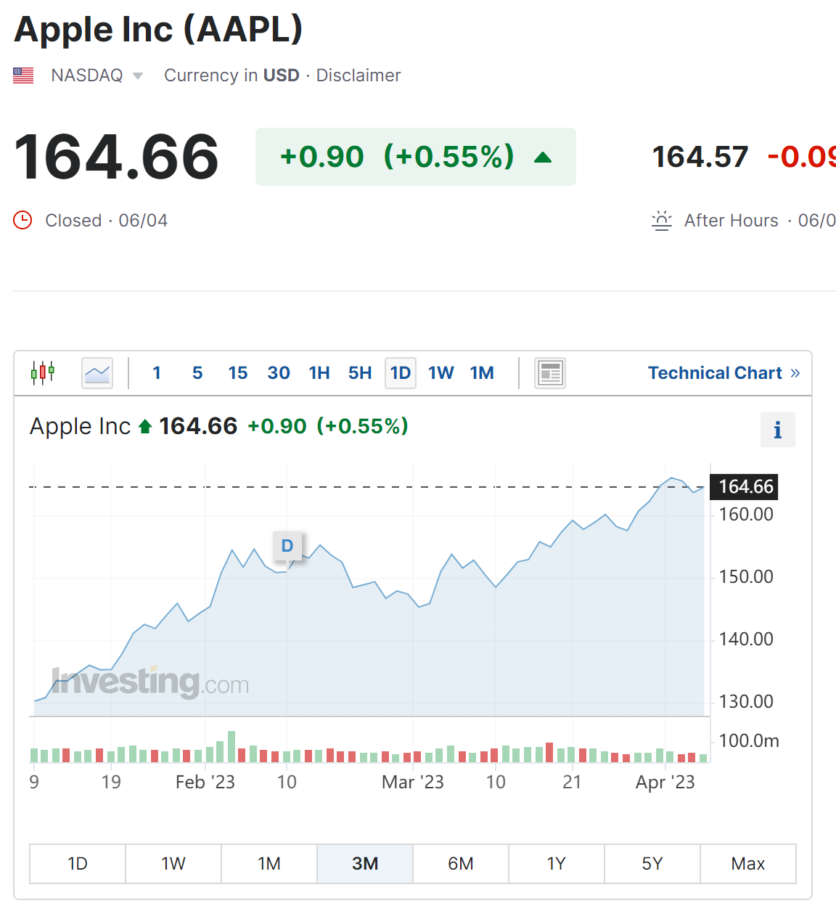
01.

Slide 4
common sense
The knowledge that all humans have
Physical principles
Chemical principles
Social norms

Slide 5
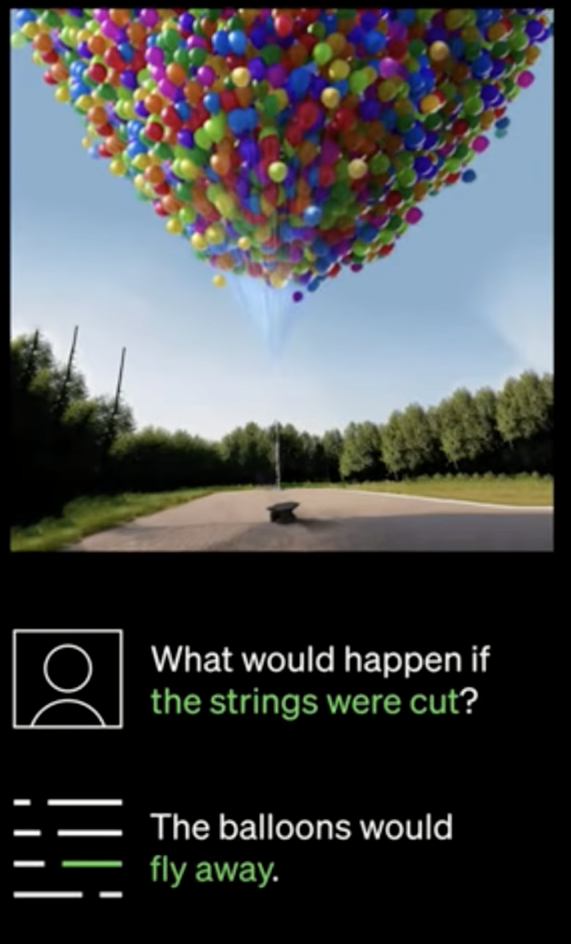
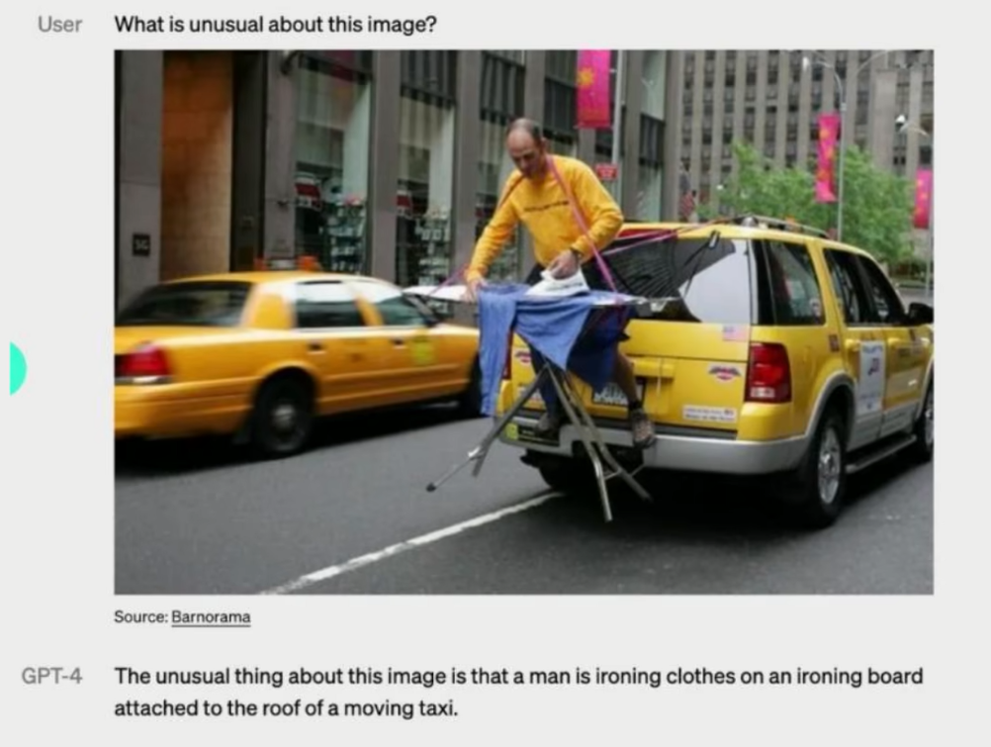
Questions for Chat-GPT4

Slide 6
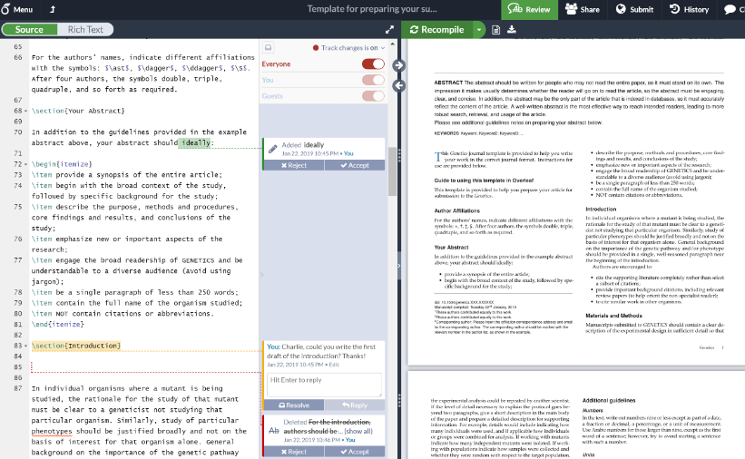
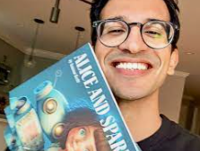
Why is it so popular?
school homework
resume
children's storybook
Midjourney AI
Canva
Overleaf

Slide 7
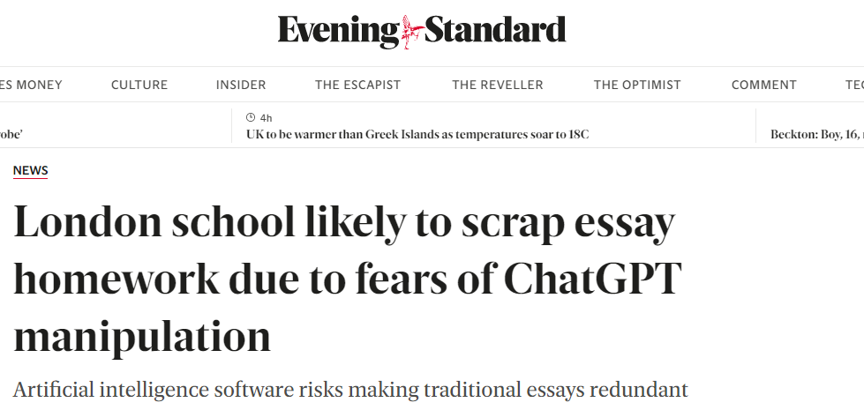
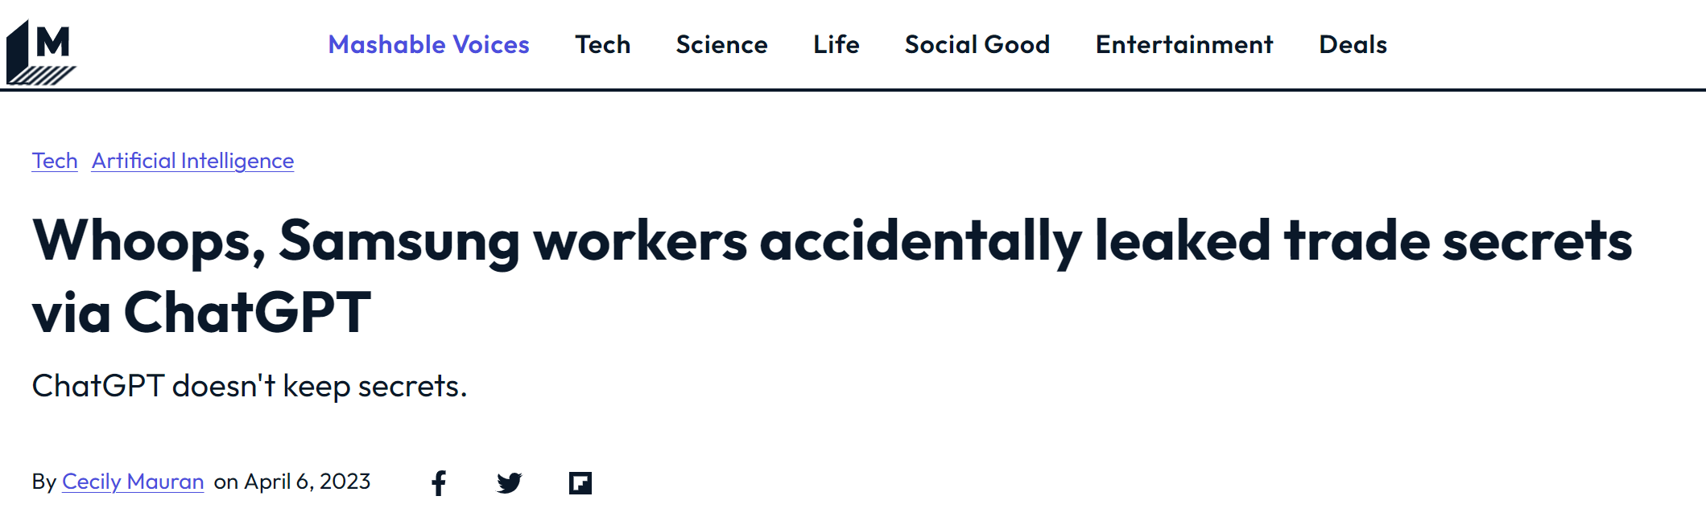
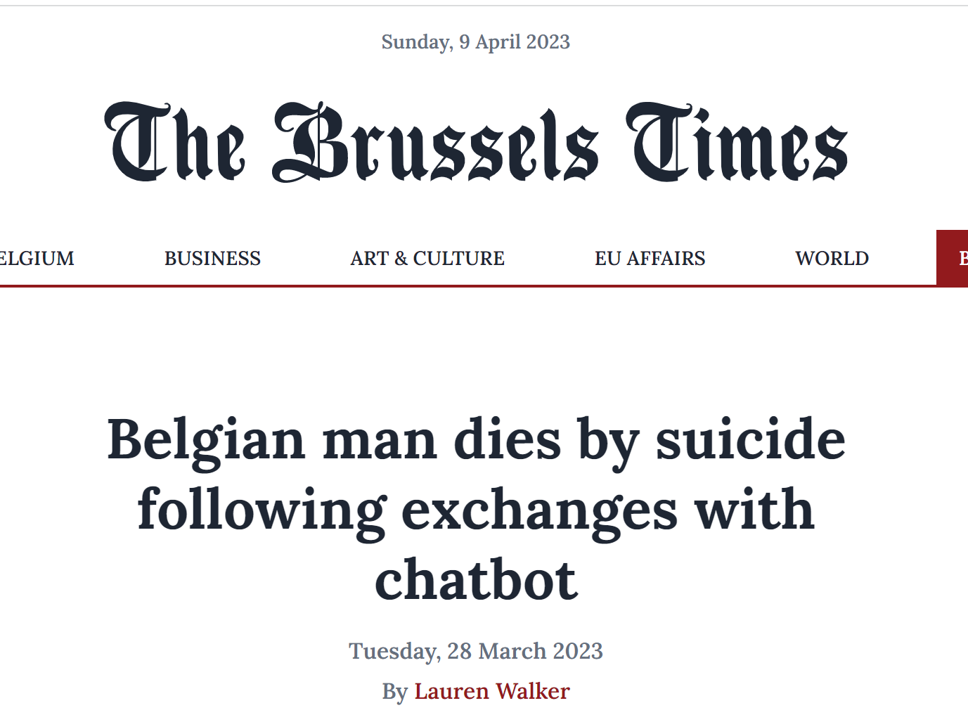
Chat GPT always good?
AI

Slide 8
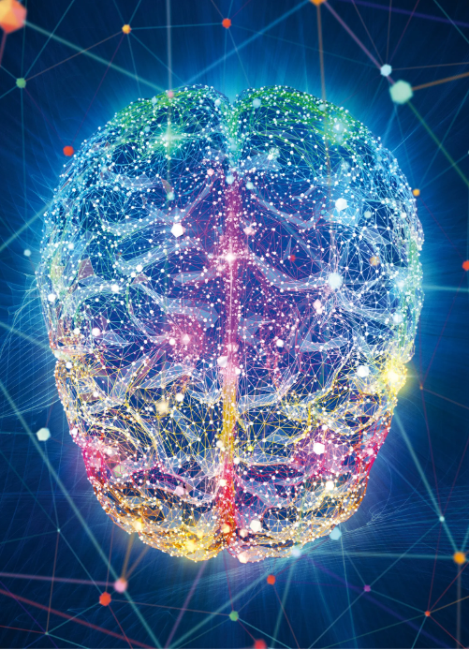
Parameter Model
Human brain's emerge
Chat GPT4
Chat GPT3
175.000.000.000
100.000.000.000.000
210.000.000.000.000

Slide 9
ARTIFICIAL INTELLIGENCE TECHNOLOGY
BYE
Thank you!

Slide 10
